Slide 1
Industry Analysis
US Insurance Industry in 2011

Slide 2
Context
Objective
Identifying segments & corresponding characteristics within the insurance industry
Dataset
Information on 689 companies sourced from the NAIC

Slide 3
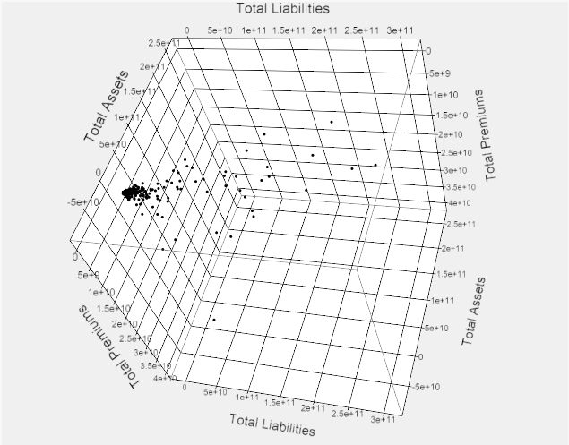
Data Description
Original Data
8 Generic Financial Metrics
Total assets, liabilities & premiums
Return on Capital
Risk Based Capital Ratio
Contribution ratios of health, life, annuity, reinsurance premiums

Slide 4
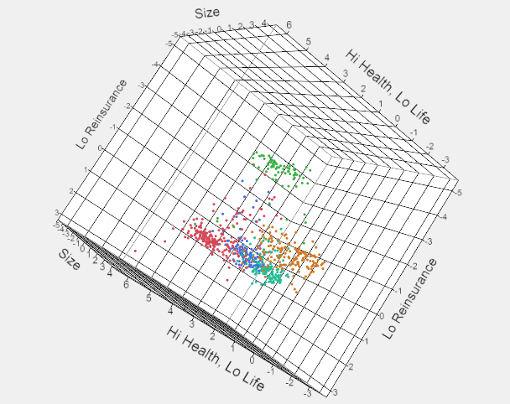
Data Analysis
Segmented Data
3 Concise, Descriptive Metrics
Size
Higher premium contribution from health than life insurance
Lower premium contribution from reinsurance

Slide 5
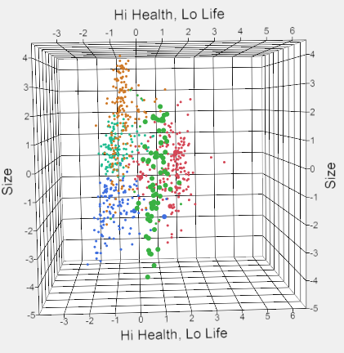
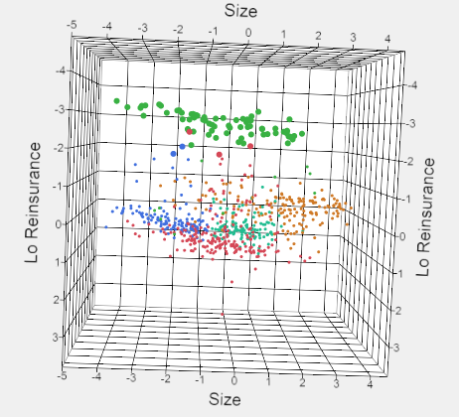
Segment Description
Green Cluster
Large variation in size
Equal contribution from health and life insurance
Above average contribution from reinsurance
Companies in Cluster
RGA Reinsurance Co, Allstate Insurance etc.

Slide 6
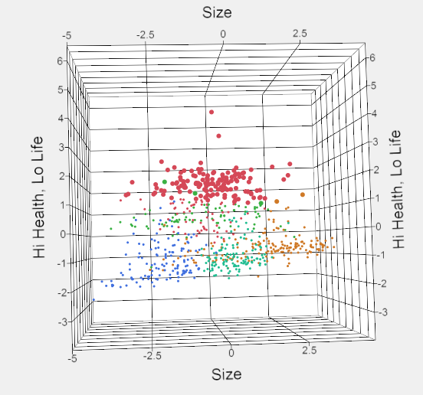
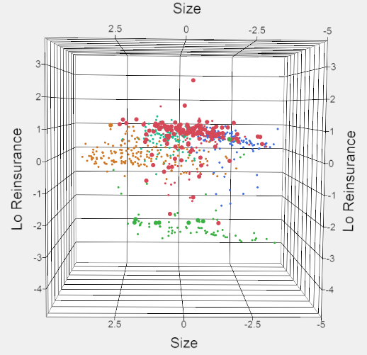
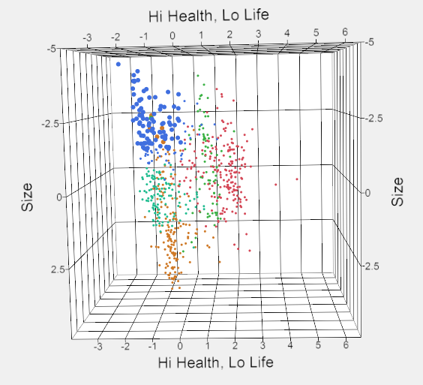
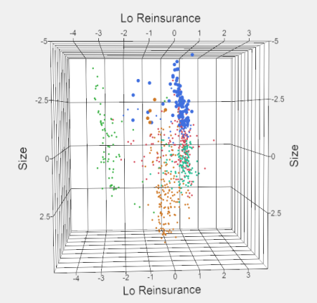
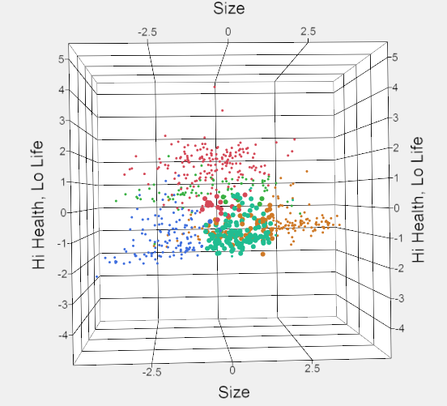
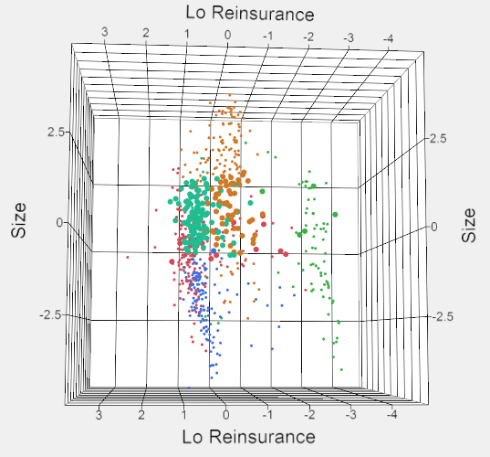
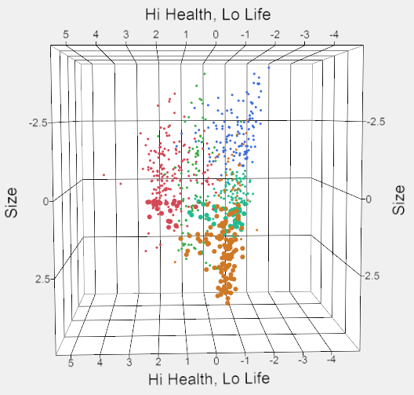
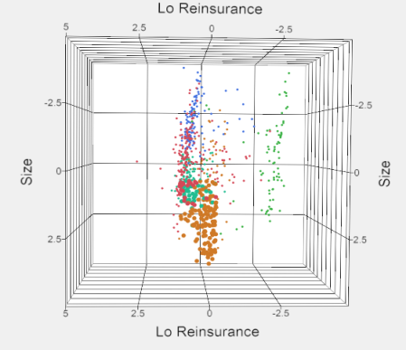
Segment Description Contd.
Maroon Cluster
Blue Cluster
Turquoise Cluster
Brown Cluster

Slide 7
Value Addition
Informed Decisions in
Industry Entry/Exit
Competitive Response/Analysis
Valuation
Analysis method applicable to
Market Segmentation
Buying/Response Propensity Estimation

Slide 8
By Souradeep Sen MS in Business Analytics souradeep.sen@utexas.edu

